Slide 1
INSTAGRAM USER ANALYTICS
Project Description: In this project we are going to Analyse Instagram user data using SQL Queries. As per the task given we are going to Analyse based on two metrics as below:
A.) Marketing:
Rewarding Most Loyal Users: People who have been using the platform for the longest time, where we need to find the 5 oldest users of the Instagram from the database provided
Remind Inactive Users to Start Posting: By sending them promotional emails to post their 1st photo, where we need to find the users who have never posted a single photo on Instagram
Declaring Contest Winner: The team started a contest and the user who gets the most likes on a single photo will win the contest now they wish to declare the winner, here we need to Identify the winner of the contest and provide their details to the team
Hashtag Researching: A partner brand wants to know, which hashtags to use in the post to reach the most people on the platform, here we need to Identify and suggest the top 5 most commonly used hashtags on the platform.
Launch AD Campaign: The team wants to know, which day would be the best day to launch Ads, here we need to find on what day of the week do most users register on? Provide insights on when to schedule an ad campaign

Slide 2
B) Investor Metrics:
User Engagement: Are users still as active and post on Instagram or they are making fewer posts, where we need to provide how many times does average user posts on Instagram. Also, provide the total number of photos on Instagram/total number of users
Bots & Fake Accounts: The investors want to know if the platform is crowded with fake and dummy accounts, where we need to provide data on users (bots) who have liked every single photo on the site (since any normal user would not be able to do this).
APPROACH: 1. Created database in MYSQL workbench as per provided in the project and gathered the information based on the task I need to complete.
2. In MYSQL workbench, starting writing SQL queries and executed to achieve the results for the tasks provided in description.
TECH-STACK: I used MYSQL Workbench 8.0CE. The main purpose behind using MYSQL workbench is that it provides the console to simply edit and administer to get better results and insights from the data. It is great tool to design, generate and manage the databases.

Slide 3
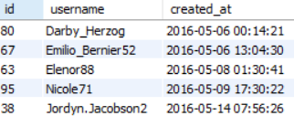

PROJECT INSIGHTS: From the project We can learn how to analyze the users data and what’s the user analysis process and how the data analysts analyze the user information and statistics, it also helps to gain knowledge on how to perform some operations to acquire the required result.
RESULT: Below is the result we achieved,
The oldest 5 users we found are in below screenshot:
There are 26 users who never posted a single photo on Instagram.
The user who got most number of likes for a single photo is shown in below screenshot:

Slide 4
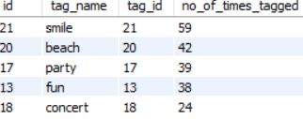
The top 5 most commonly used hashtags on the Instagram Platform are:
The day of the week most users are registering are Sunday and Thursday which is best fir to launch a AD Campaign.
The number of time average user posts on Instagram is 3.47 time.
The total number of photos on Instagram/total number of users is 2.57.
There are total 13 numbers of Bots or fake accounts who have liked every single photo on the site.

